Slide 1
Chapter 3
The Greedy Method

Slide 2
The greedy method
Suppose that a problem can be solved by a sequence of decisions. The greedy method has that each decision is locally optimal. These locally optimal solutions will finally add up to a globally optimal solution.
Only a few optimization problems can be solved by the greedy method.

Slide 3
A Simple Example
Problem: Pick k numbers out of n numbers such that the sum of these k numbers is the largest.
Algorithm:
    FOR i = 1 to k
    Pick out the largest number and
    delete this number from the input.
    ENDFOR

Slide 4
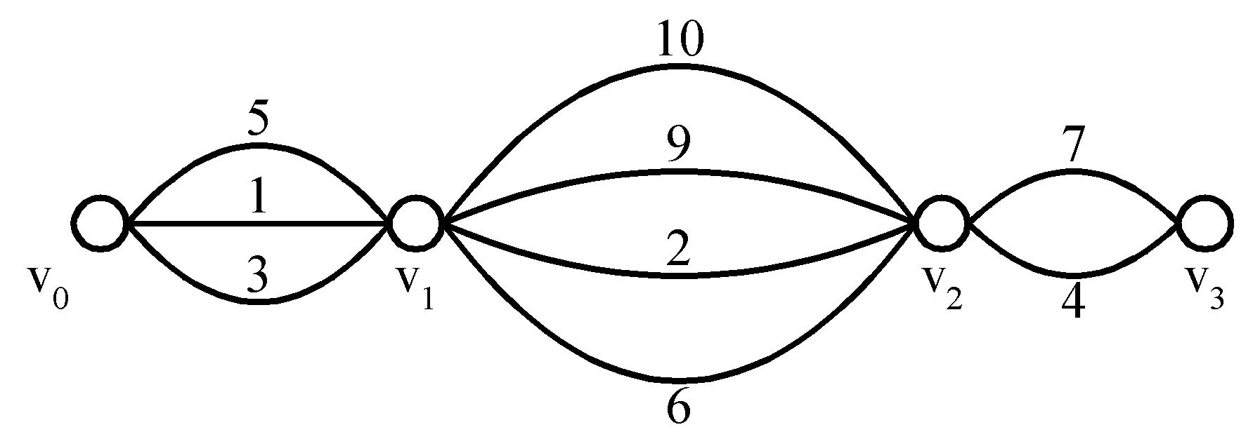
Shortest Paths on a Special Graph
Problem: Find a shortest path from v₀ to v₃.
The greedy method can solve this problem.
The shortest path: 1 + 2 + 4 = 7.

Slide 5
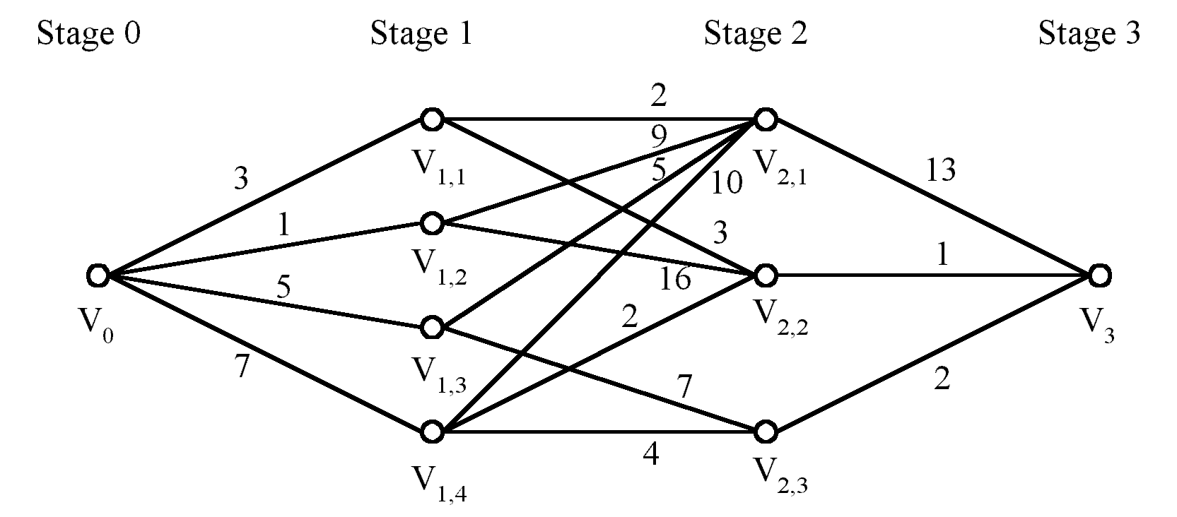
Shortest Paths on a Multi-stage Graph
Problem: Find a shortest path from v₀ to v₃ in a multi-stage graph.
Greedy method: v₀v_{1,2}v_{2,1}v₃ = 23
Optimal: v₀v_{1,1}v_{2,2}v₃ = 7
The greedy method does not work.

Slide 6
This problem can be solved by the dynamic programming method which will be introduced later.

Slide 7
Minimum Spanning Trees (MST)
It may be defined on Euclidean space points or on a graph.
G = (V, E): weighted connected undirected graph
Spanning tree: T = (V, S), S ⊆ E.
Minimum spanning tree(MST): a spanning tree with the smallest total weight.

Slide 8
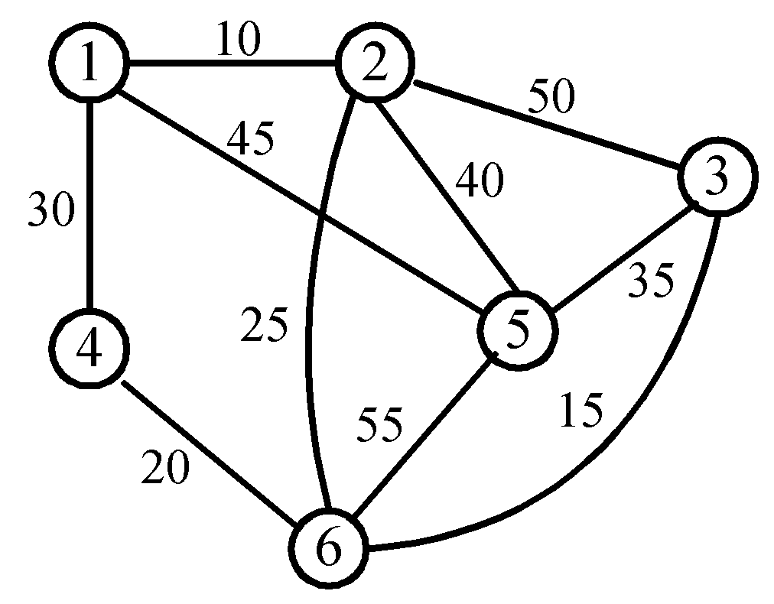
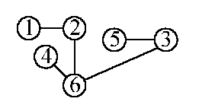
An Example of MST
A graph and one of its minimum spanning trees.

Slide 9
Kruskal’s Algorithm for Finding MST
Input : A weighted, connected and undirected graph
G = (V, E ).
Output : A minimal spanning tree for G.
T : = φ
While T contains less than n - 1 edges do
Begin
Choose an edge (v, w) from E of the smallest weight
Delete (v, w) from E
If (the adding of (v, w) to T does not create a cycle in T) then
Add (v, w) to T
Else
Discard (v, w)
End

Slide 10
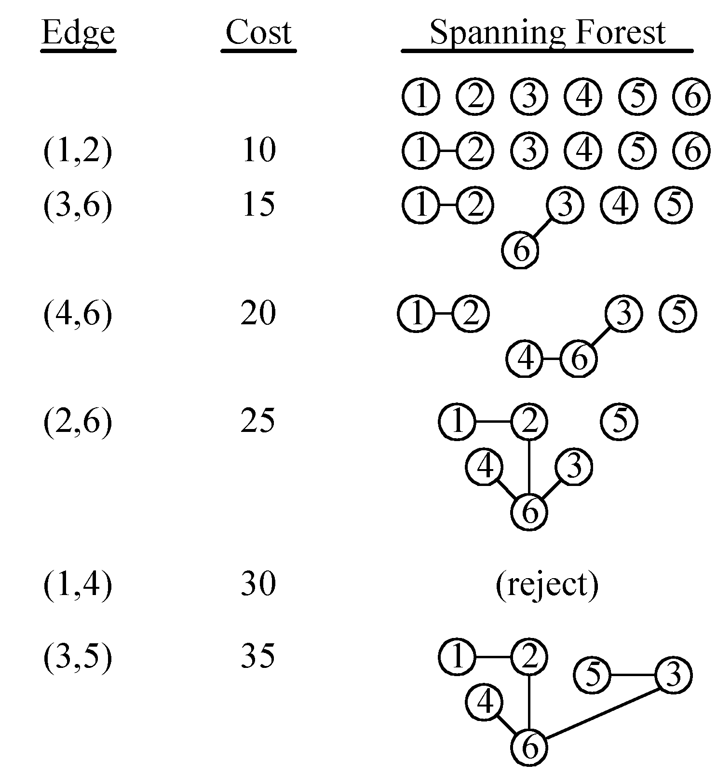
An example of Kruskal’s algorithm

Slide 11
The Details for Constructing an MST
How do we check if a cycle is formed when a new edge is added?
  By the SET and UNION algorithm introduced later.
A tree in the forest is used to represent a SET.
If (u, v) ∈ E and u, v are in the same set, then the addition of (u, v) will form a cycle.
If (u, v) ∈ E and u∈S₁ , v∈S₂ , then perform UNION of S₁ and S₂ .

Slide 12
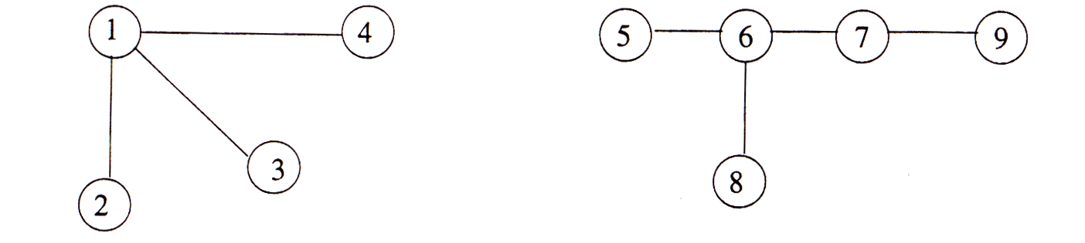
A spanning forest
If (3,4) is added, since 3 and 4 belong to the same set,
a cycle will be formed.
If (4,5) is added, since 4 and 5 belong to different sets,
a new forest (1,2,3,4,5,6,7,8,9) is created.
Thus we are always performing the union of two sets.

Slide 13
Time Complexity of Kruskal’s Algorithm
Time complexity:
O(|E|log|E|) = O(n²logn), where n = |V|.

Slide 14
Prim’s Algorithm for Finding an MST
Step 1: x ∈ V, Let A = {x}, B = V - {x}.
Step 2: Select (u, v) ∈ E, u ∈ A, v ∈ B such that (u, v) has the smallest weight between A and B.
Step 3: Put (u, v) into the tree. A = A ∪ {v}, B = B - {v}
Step 4: If B = ∅, stop; otherwise, go to Step 2.
Time complexity : O(n²), n = |V|.
(see the example on the next page)

Slide 15
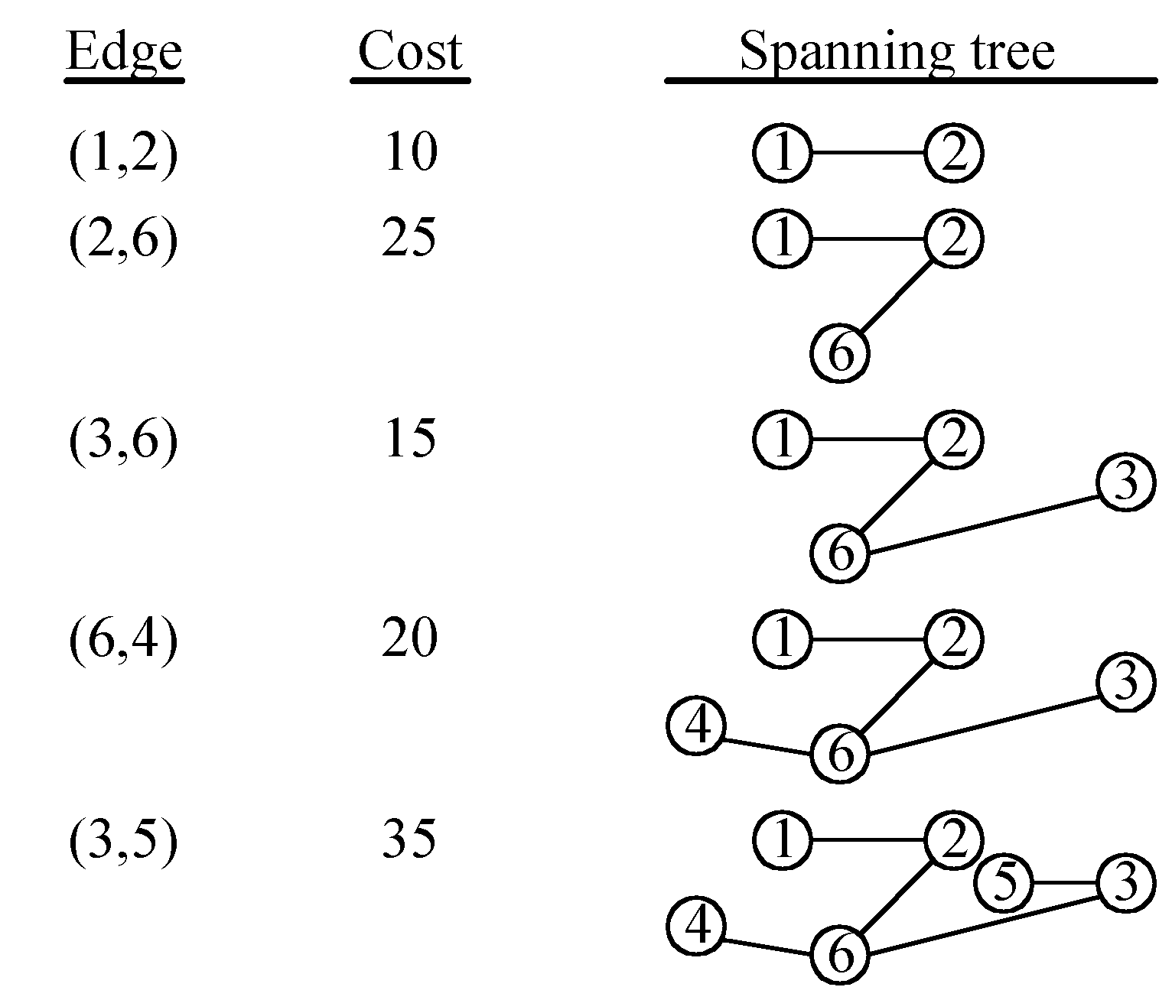
An Example for Prim’s Algorithm

Slide 16
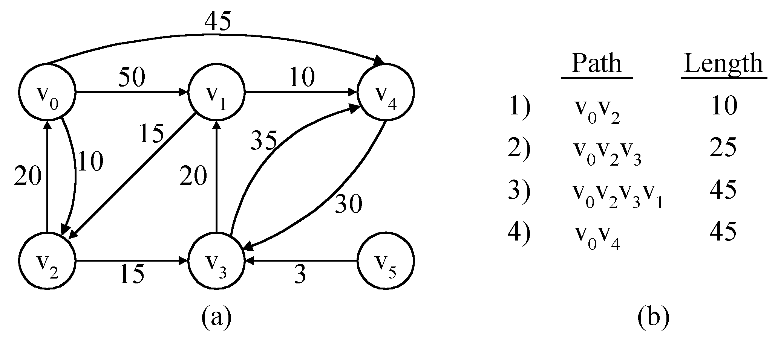
The Single-Source Shortest Path Problem
Shortest paths from v₀ to all destinations

Slide 17
Dijkstra’s Algorithm to Generate Single Source Shortest Paths
Input: A directed graph G = (V, E) and a source vertex v₀. For each edge (u, v) ∈ E, there is a nonnegative number c(u, v) associated with it. |V|= n + 1.
Output: For each v ∈ V, the length of a shortest path from v₀ to v.
S : = {v₀}
For i : = 1 to n do
Begin
If (v₀ , v_{i}) ∈ E then
L(v_{i}) : = c(v₀ , v_{i})
else
L(v_{i}) : = ∞
End
(continued on the next page)

Slide 18
Dijkstra’s Algorithm to Generate Single Source Shortest Paths (cont’d)
For i : = 1 to n do
Begin
Choose u from V - S such that L(u) is the smallest
S : = S ∪{u} (* Put u into S *)
For all w in V - S do
L(w) : = min(L(w), L(u) + c(u, w))
End

Slide 19
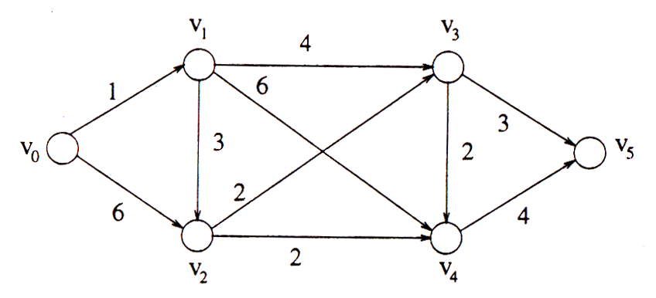
Vertex Shortest distance to v₀ (length)
v₁ v₀v₁ (1)
v₂ v₀v₁v₂ (1 + 3 = 4)
v₃ v₀v₁v₃ (1 + 4 = 5)
v₄ v₀v₁v₂v₄ (1 + 3 + 2 = 6)
v₅ v₀v₁v₃v₅ (1 + 4 + 3 = 8)

Slide 20
Time complexity of Dijkstra’s algorithm is O(n²).
It is optimal.

Slide 21
Given two sorted lists L₁ and L₂, L₁ = (a₁ , a₂ , ... , a_{n1}) and L₂ = (b₁ , b₂ , ... , b_{n2}), we can merge L₁ and L₂ into a sorted list by using the following algorithm.

Slide 22
Linear Merge Algorithm
Input: Two sorted lists, L₁ = ( a₁ , a₂ , ... , a_{n1}) and L₂ = (b₁ , b₂ , ... , b_{n2}).
Output: A sorted list consisting of elements in L₁ and L₂ .
Begin
i : = 1
j : = 1
do
compare a_{i} and b_{j}
if a_{i} > b_{j} then output b_{j} and j : = j + 1
else output a_{i} and i : = i + 1
while (i ≤ n1 and j ≤ n2)
if i > n1 then output b_{j} , b_{j+1} , ... , b_{n2} ,
else output a_{i} , a_{i+1} , ... , a_{n1} .
End.

Slide 23
If more than two sorted lists are to be merged, we can still apply the linear merge algorithm, which merges two sorted lists, repeatedly. These merging processes are called 2-way merge because each merging step only merges two sorted lists.

Slide 24
A Greedy Algorithm to Generate an Optimal 2-Way Merge Tree
Input: m sorted lists, L_{i}, i = 1, 2, ... , m, each L_{i} consisting of n_{i} elements.
Output: An optimal 2-way merge tree.
Step 1. Generate m trees, where each tree has exactly one node (external node) with weight n_{i} .
Step 2. Choose two trees T₁ and T₂ with minimal weights.
Step 3. Create a new tree T whose root has T₁ and T₂ as its subtrees and weight are equal to the sum of weights of T₁ and T₂ .
Step 4. Replace T₁ and T₂ by T.
Step 5. If there is only one tree left, stop and return; otherwise, go to Step 2.

Slide 25
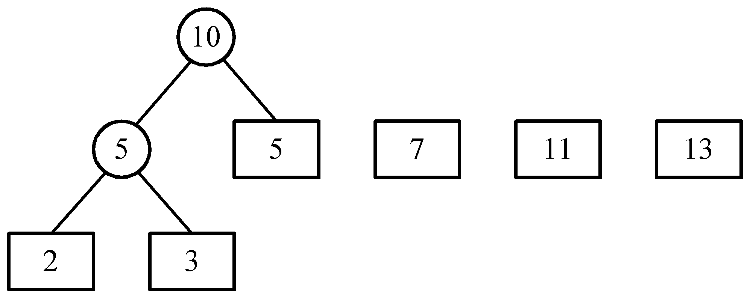
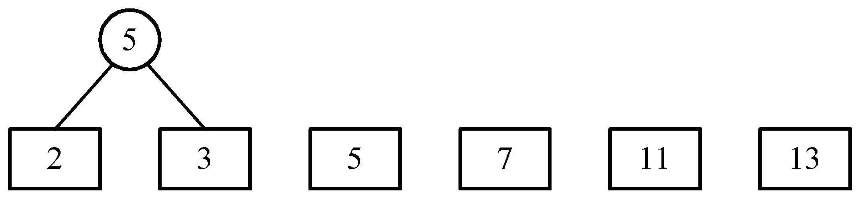
An example of 2-way merging
Example: 6 sorted lists with lengths 2, 3, 5, 7, 11 and 13.

Slide 26
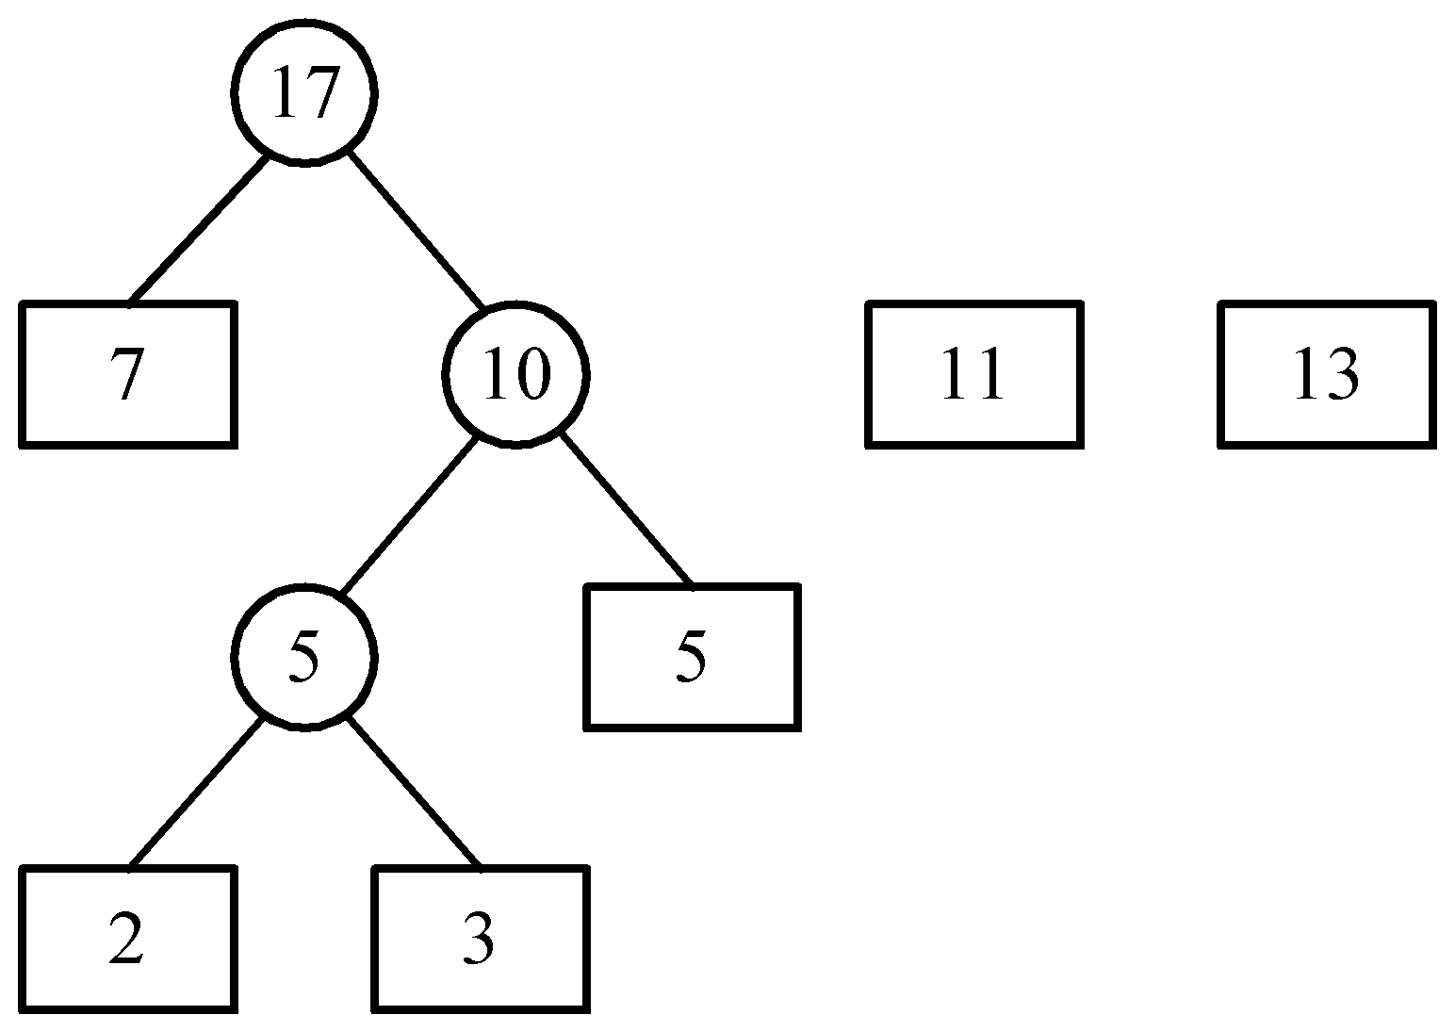
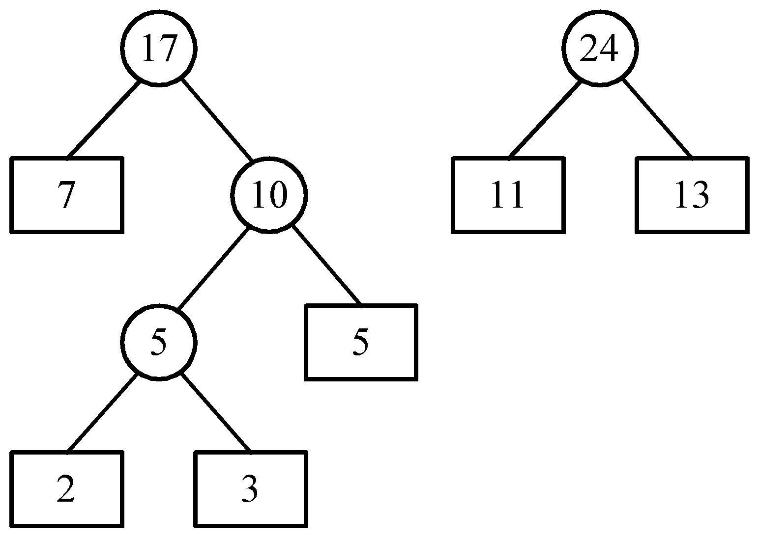
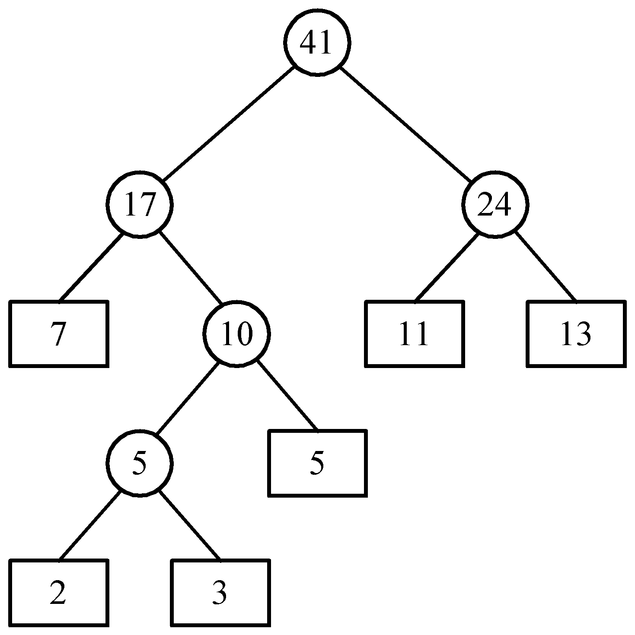
Time complexity of the 2-way merge algorithm is O(n log n).

Slide 27
Huffman codes
In telecommunication, how do we represent a set of messages, each with an access frequency, by a sequence of 0’s and 1’s?
To minimize the transmission and decoding costs, we may use short strings to represent more frequently used messages.
This problem can by solved by using the 2-way merge algorithm.

Slide 28
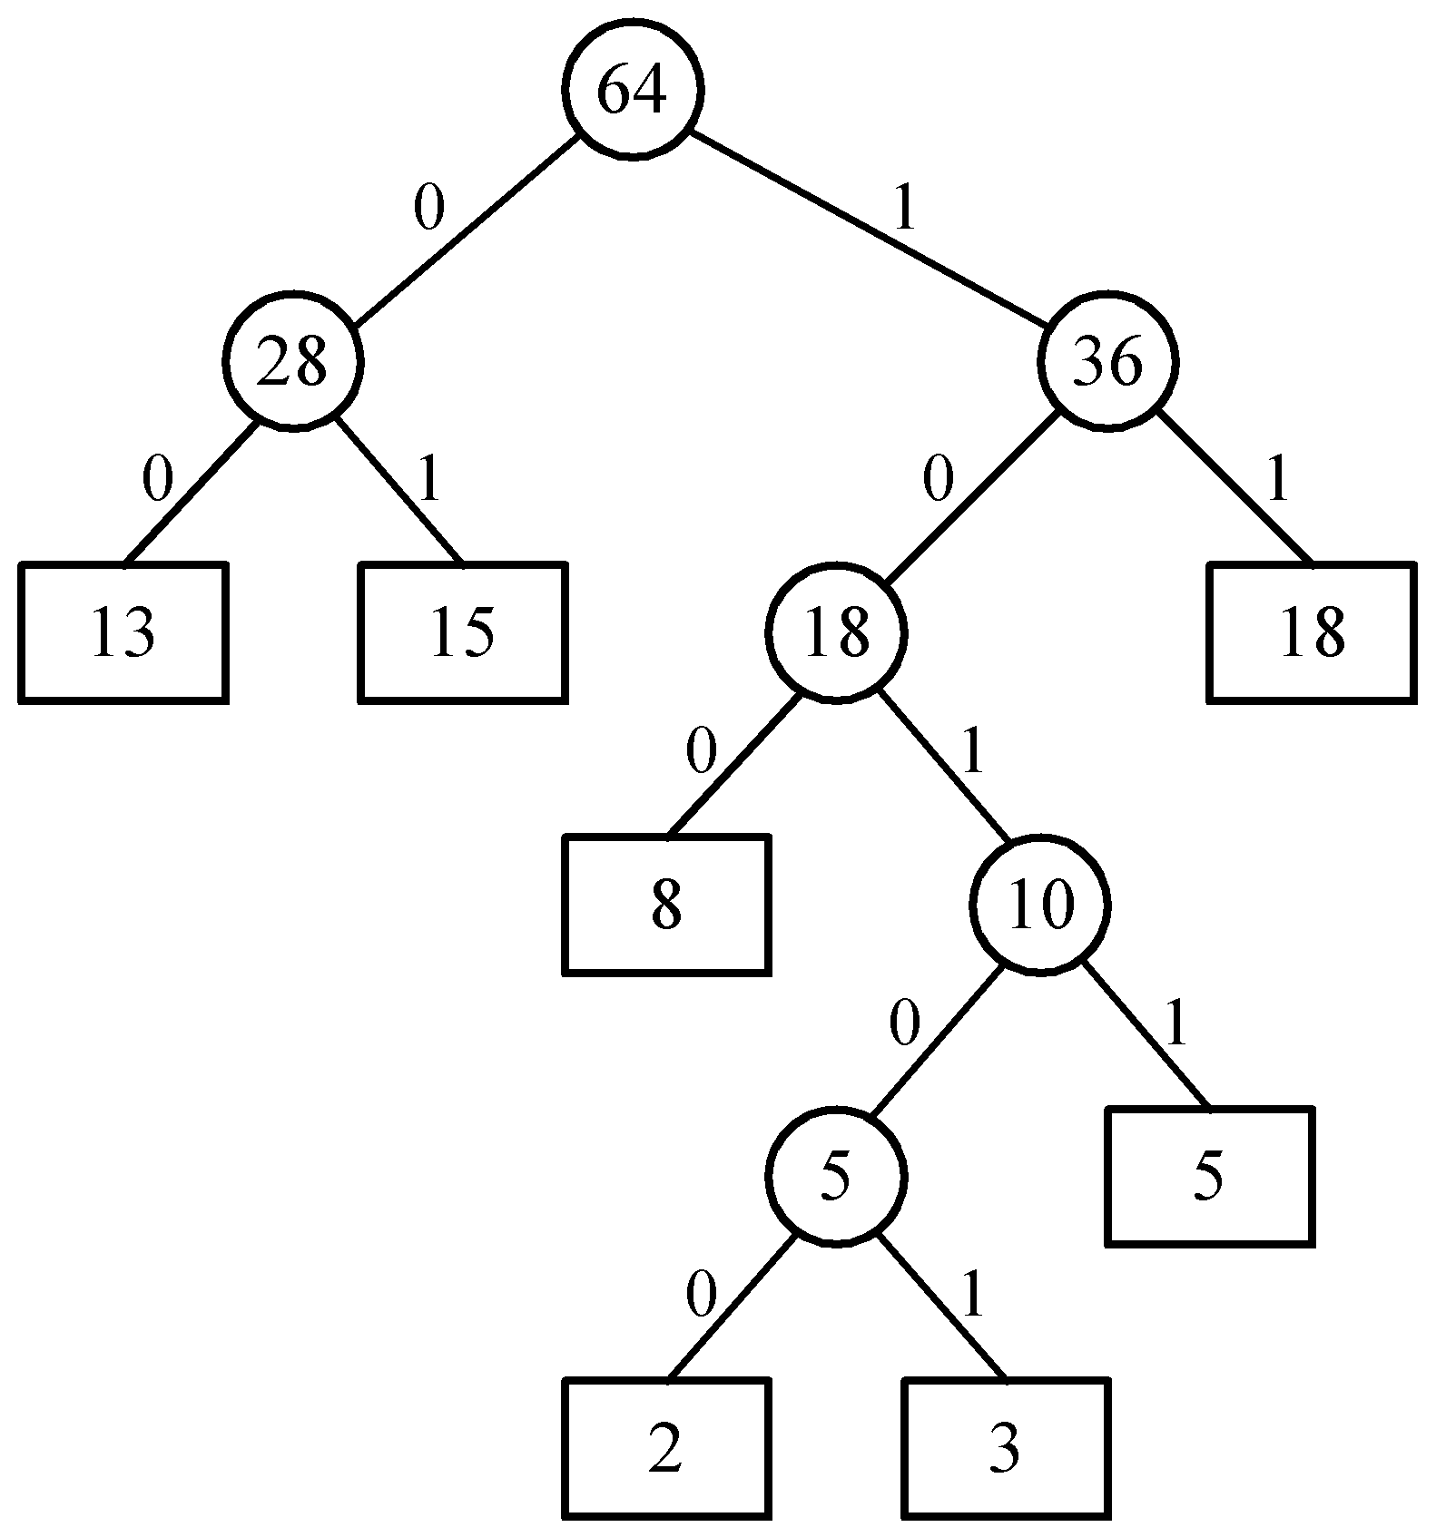
An example of Huffman algorithm
Symbols: A, B, C, D, E, F, G
freq. : 2, 3, 5, 8, 13, 15, 18
Huffman codes:
A: 10100 B: 10101 C: 1011
D: 100 E: 00 F: 01
G: 11
A Huffman code Tree

Slide 29
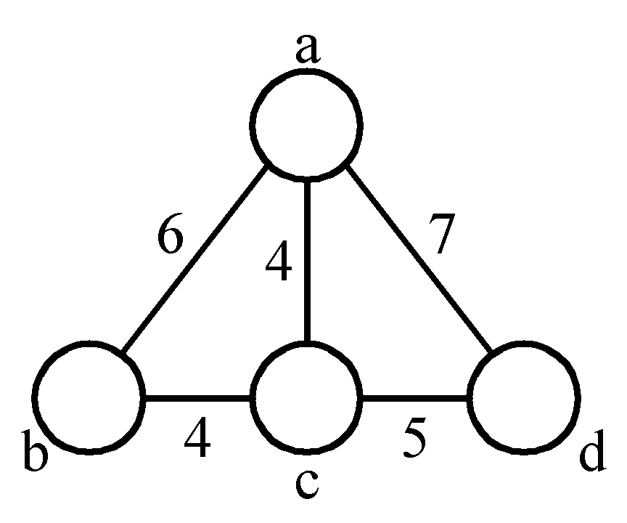
The minimal cycle basis problem
3 cycles:
A₁ = {ab, bc, ca}
A₂ = {ac, cd, da}
A₃ = {ab, bc, cd, da}
where A₃ = A₁ ⊕ A₂
(A ⊕ B = (A∪B)-(A∩B))
A₂ = A₁ ⊕ A₃
A₁ = A₂ ⊕ A₃
Cycle basis: {A₁, A₂} or {A₁, A₃} or {A₂, A₃}

Slide 30
Def: A cycle basis of a graph is a set of cycles such that every cycle in the graph can be generated by applying ⊕ on some cycles of this basis.
The weighted cycle basis problem:
Given a graph, find a minimal cycle basis of this graph.

Slide 31
The minimal cycle basis is {A₁, A₂}, where A₁={ab, bc, ca} and A₂= {ac, cd, da}.

Slide 32
A greedy algorithm for finding a minimal cycle basis:
  Step 1: Determine the size of the minimal cycle basis, denoted as k.
  Step 2: Find all of the cycles. Sort all cycles by weights.
  Step 3: Add cycles to the cycle basis one by one. Check if the added cycle is a combination of some cycles already existing in the basis. If yes, delete this cycle.
  Step 4: Stop if the cycle basis has k cycles.

Slide 33
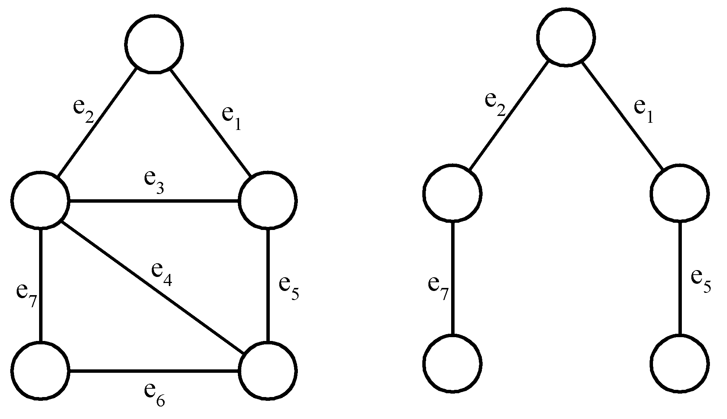
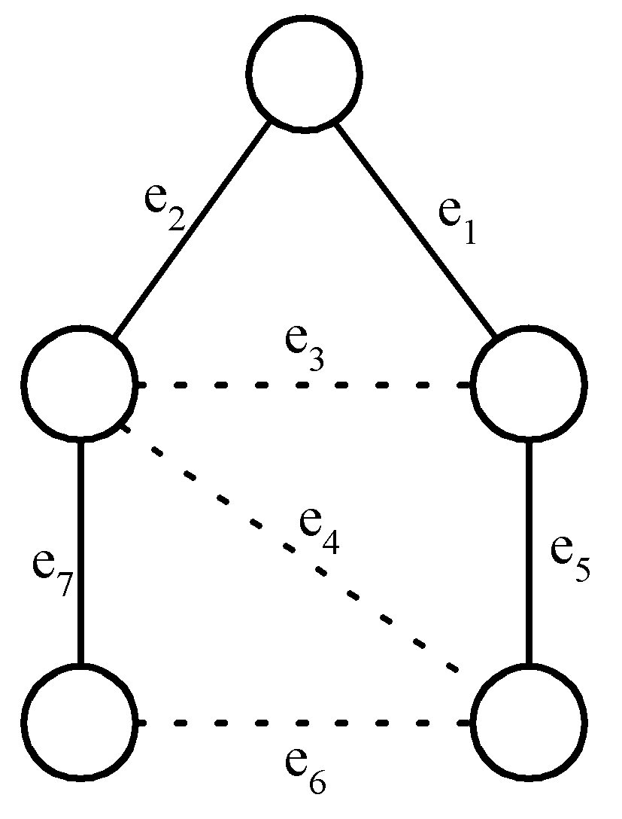
Detailed Steps for the Minimal Cycle Basis Problem
Step 1 :
A cycle basis corresponds to the fundamental set of cycles with respect to a spanning tree.
a fundamental set of cycles
a graph
a spanning tree
# of cycles in a cycle basis:
= k
= |E| - (|V|- 1)
= |E| - |V| + 1

Slide 34
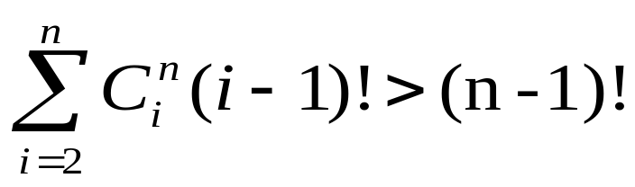
Step 2:
How to find all cycles in a graph?
[Reingold, Nievergelt and Deo 1977]
How many cycles are there in a graph in the worst case?
In a complete digraph of n vertices and n(n-1) edges:
Step 3:
  How to check if a cycle is a linear combination of some cycles?
  Using Gaussian elimination.

Slide 35
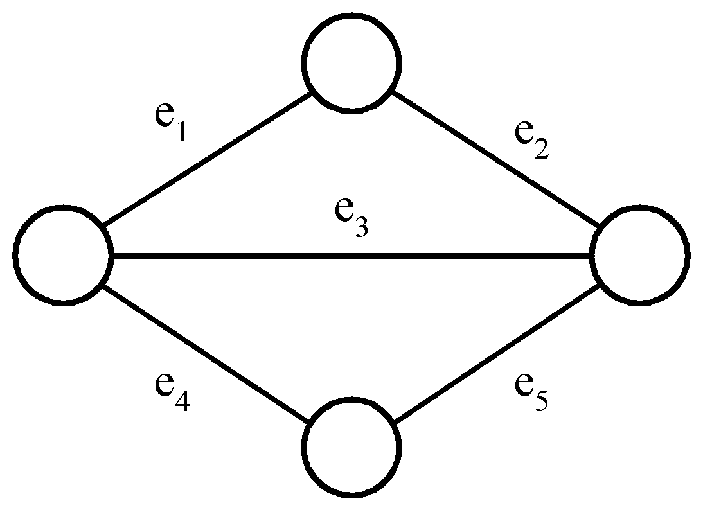
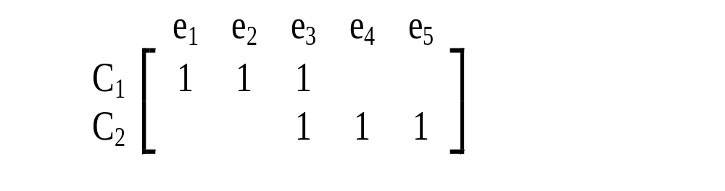
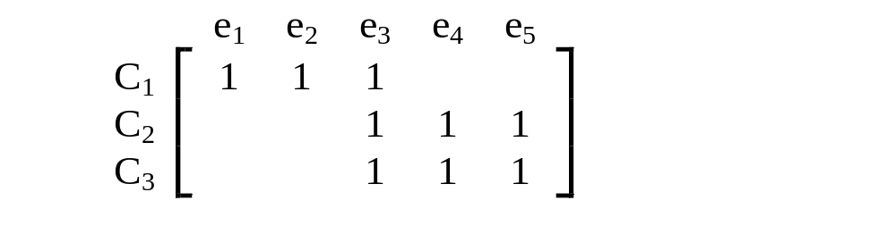
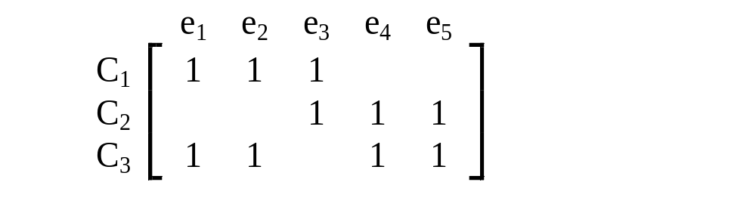
Gaussian elimination
2 cycles C₁ and C₂ are represented by a 0/1 matrix
E.g.
⊕ on rows 1 and 3
Add C₃
on rows 2 and 3 : empty
∵C₃ = C₁ ⊕ C₂

Slide 36
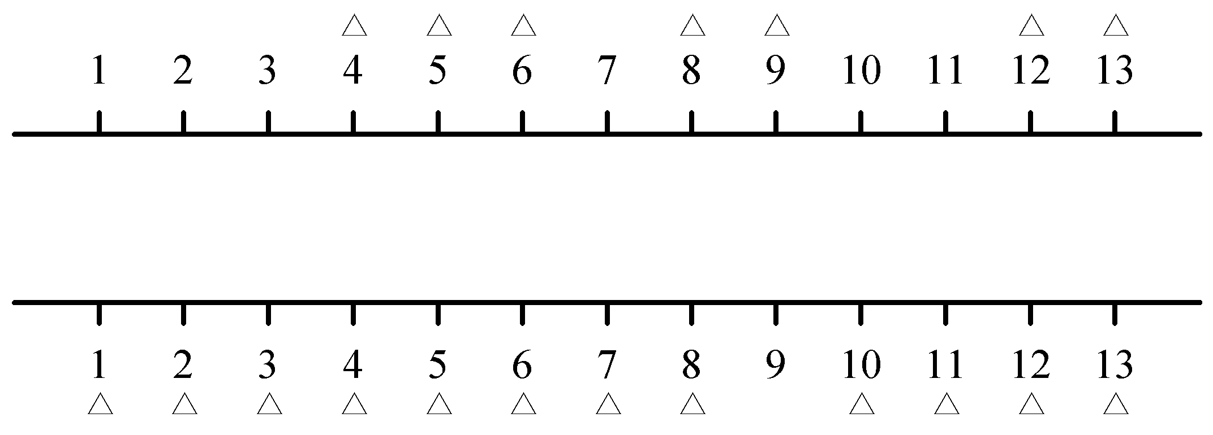
The 2-terminal One to Any Special Channel Routing Problem
Def: Given two sets of terminals on the upper and lower rows, respectively, we have to connect each upper terminal to the lower row in a one-to-one fashion. This connection requires that the number of tracks used is minimized.

Slide 37

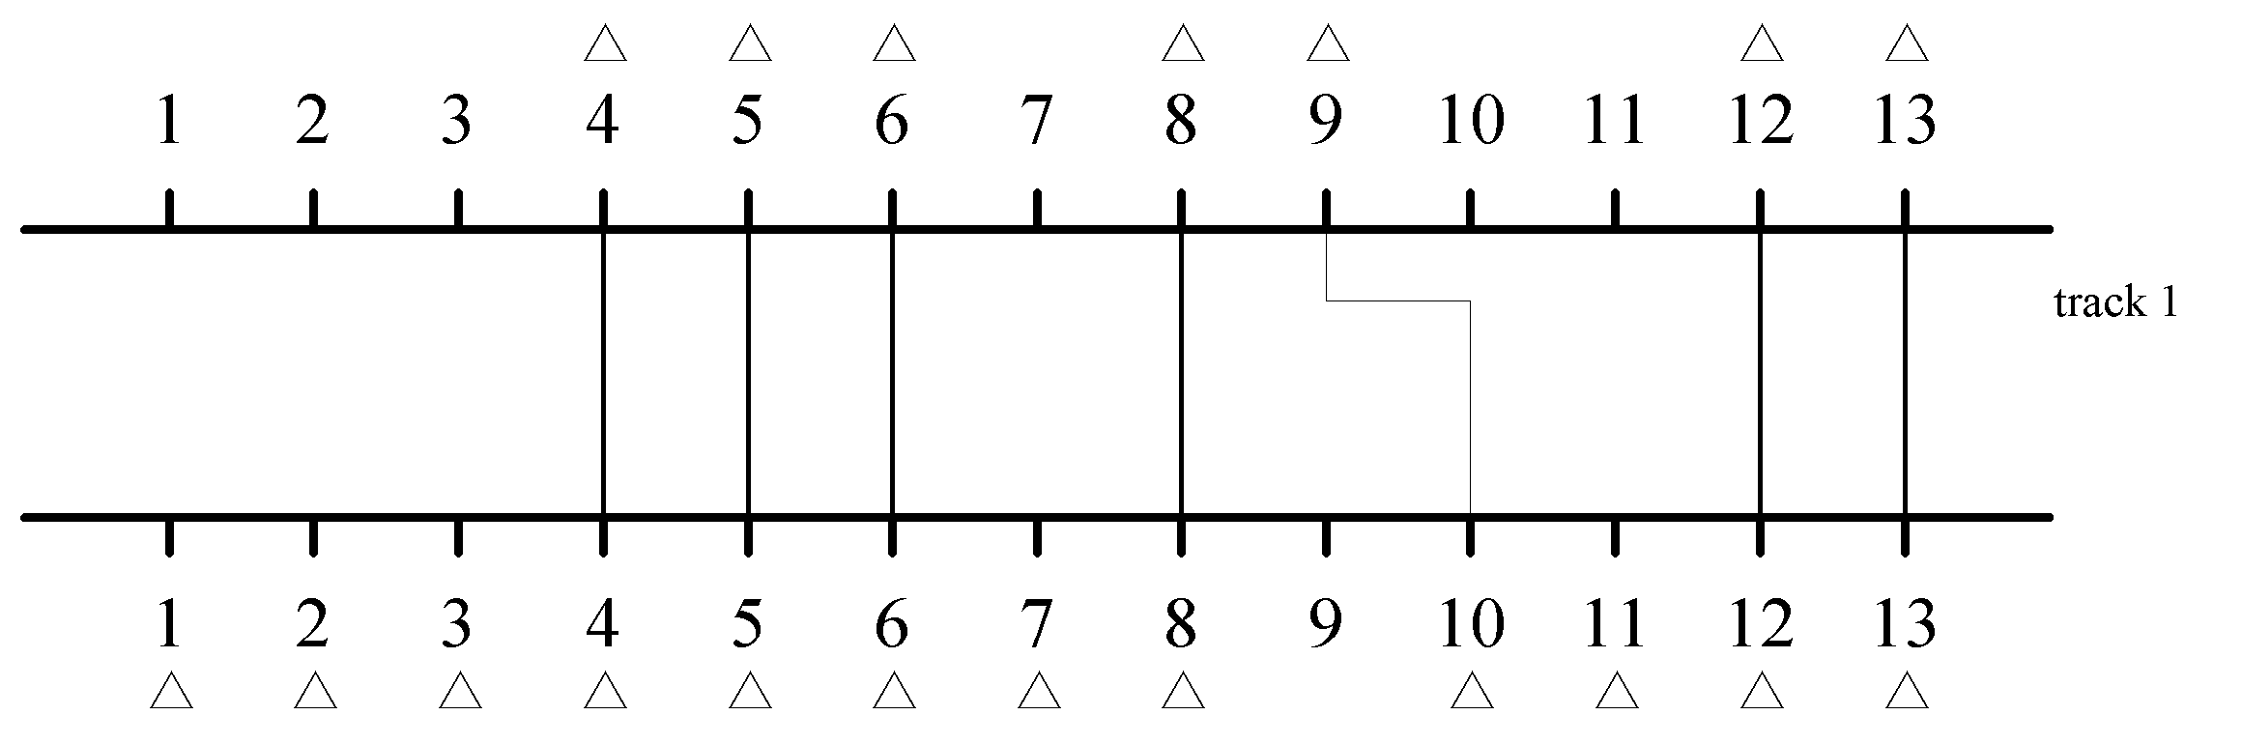
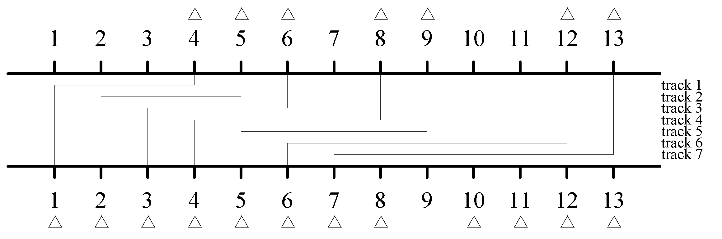
Two Feasible Solutions

Slide 38
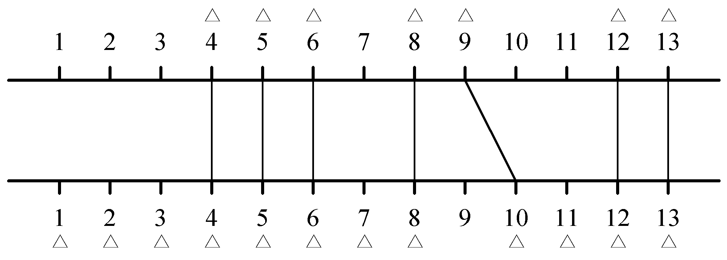
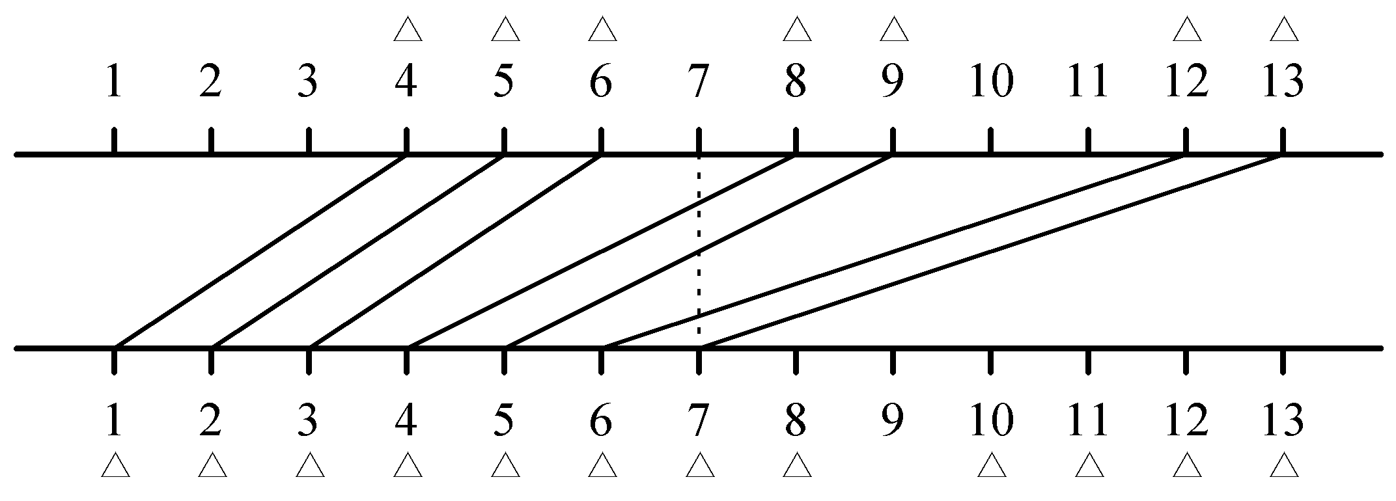
Redrawing Solutions
(a) Optimal solution
(b) Another solution

Slide 39
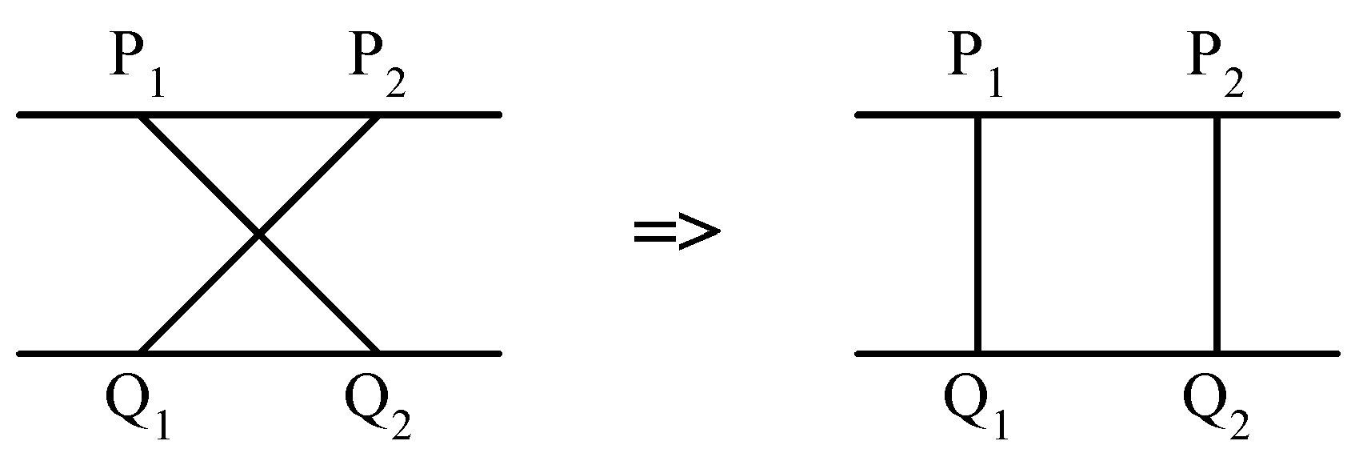
At each point, the local density of the solution is the number of lines the vertical line intersects.
The problem: to minimize the density. The density is a lower bound of the number of tracks.
Upper row terminals: P₁ ,P₂ ,…, P_{n} from left to right.
Lower row terminals: Q₁ ,Q₂ ,…, Q_{m} from left to right m > n.
It would never have a crossing connection:

Slide 40
Suppose that we have the minimum density d of a problem instance. We can use the following greedy algorithm:
Step 1 : P₁ is connected Q₁.
Step 2 : After P_{i} is connected to Q_{j}, we check whether P_{i+1} can be connected to Q_{j+1}. If the density is increased to d+1, try to connect P_{i+1} to Q_{j+2}.
Step 3 : Repeat Step2 until all P_{i}’s are connected.

Slide 41
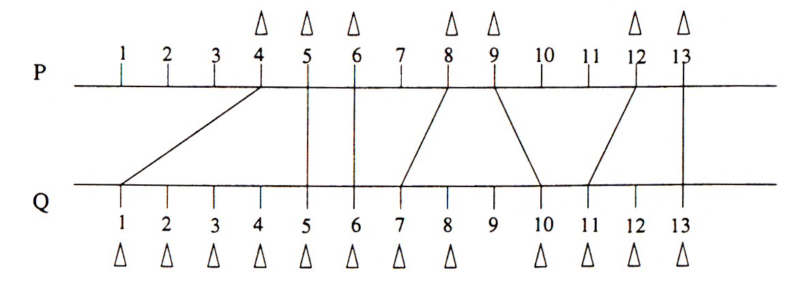
d=1
A Solution Produced by the Greedy Algorithm.

Slide 42
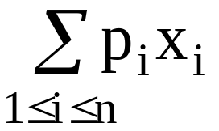
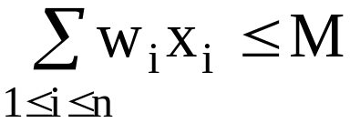
The knapsack Problem
n objects, each with a weight w_{i} > 0
a profit p_{i} > 0
capacity of knapsack: M
Maximize
Subject to
0 ≤ x_{i} ≤ 1, 1 ≤ i ≤ n

Slide 43
The knapsack problem is different from the 0/1 knapsack problem. In the 0/1 knapsack problem, x_{i} is either 0 or 1 while in the knapsack problem, 0 ≤ x_{i} ≤ 1.

Slide 44
The knapsack algorithm
The greedy algorithm:
Step 1: Sort p_{i}/w_{i} into nonincreasing order.
Step 2: Put the objects into the knapsack according
to the sorted sequence as far as possible.
e.g.
  n = 3, M = 20, (p₁, p₂, p₃) = (25, 24, 15)
  (w₁, w₂, w₃) = (18, 15, 10)
  Sol: p₁/w₁ = 25/18 = 1.32
  p₂/w₂ = 24/15 = 1.6
  p₃/w₃ = 15/10 = 1.5
  Optimal solution: x₁ = 0, x₂ = 1, x₃ = 1/2

